Slide 1
Team MediMinds

Slide 2
Aryan Tyagi
Sanket Raikwar
Swarup Deshmukh
Shivansh Saigal
Sohini Dutta

Slide 3
Ideas Proposed
ChatBot
Health Plan Comparison Tool
Customer Relationship Management Portal

Slide 4
HealthCare Bot
ChatBot that helps you for Healthcare queries

Slide 5
Case Study
Many individuals struggle to navigate the complexities of their health insurance plans, unfamiliar with medical jargon and overwhelmed by plan details, felt hesitant to contact her insurance company due to potential wait times and complex explanations.

Slide 6
Problem Statements
Navigating the complexities of health insurance plans can be overwhelming, particularly for individuals unfamiliar with medical terminology or specific plan details. Traditional methods like contacting insurance companies or healthcare providers often involve:
Long wait times
Limited accessibility
Difficulty understanding complex terms

Slide 7
Solution of Problem
A conversational AI (artificial intelligence) chatbot integrated into a health insurance platform or healthcare provider website. This chatbot will:
24/7 availability
User-friendly communication
Personalized responses
Simplify complex information
Answer a wide range of questions

Slide 8
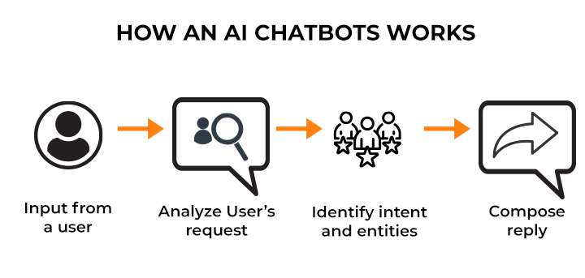

Slide 9
Benefits of our Proposed Solution
01
Reduced wait time
02
Simplified information
03
24/7 availability

Slide 10
Plan Picker
Healthcare insurance plan comparison app

Slide 11
Case Study
A family consisting of two adults and two young children faced the annual task of renewing their family health insurance plan. The current plan was expiring, and the primary caregiver felt overwhelmed by the complexity of available options.

Slide 12
Problem Statements
Choosing the right health insurance plan is often overwhelming and confusing for individuals and families. Navigating complex terminology, comparing plan features, and understanding cost implications can be a daunting task. This leads to:
Information overload
Difficulty in comparison
Uncertain decision-making

Slide 13
Solution of Problem
A user-friendly web platform that empowers individuals and families to compare and choose health insurance plans effectively. This platform will:
Centralize information
Simplify comparison
Personalize recommendations
Educate and empower

Slide 14
Key Parameters
When comparing health insurance plans, several key parameters are crucial to consider:
Coverage
Cost
Customer service
Renewal process

Slide 15
User Login to platform
Browse Plans or Search for Specific Plans
User Select One or more Plan to compare
User might want personalized recommendation
Work Flow
User choose a plan

Slide 16
Benefits of our Proposed Solution
01
Save Time and Efforts
02
Improves Decision Making
03
Potentially lower costs

Slide 17
Customer Relationship Management
For better retention

Slide 18
Case Study
Every year insurance plans have to be renewed, which creates an opportunity for the competition increase its market share. At this time a customer has so many factors to account for like :
Premium to be paid
Services offered
Claim settlement ratio
Most importantly past “RELATIONSHIP”

Slide 19
Problem Statements
For an insurance company, renewals play a big role in its revenue as acquiring new customers is an expensive affair, a lot goes into marketing, sales and commissions. The best possible way to improve customer retention is :
Keep the customer engaged (Via emails or SMS)
Regular follow-ups
Timely updates about renewals
Quick and prompt response when the customer needs it

Slide 20
Solution of Problem
A very simple solution to improve the profitability, customer experience and most importantly retention is to have a robust customer relationship management system which has the following new features to make it an omni-channel solution :
Build accountability for the service requests
Marketing modules to timely shoot updates
Maintain centralized customer database

Slide 21
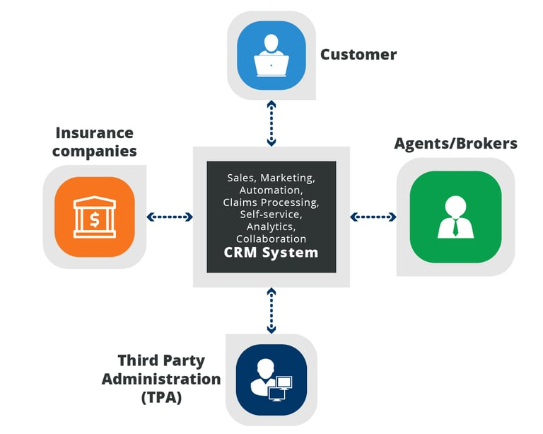

Slide 22
Benefits of our Proposed Solution
01
Save Time and Efforts
02
Improves customer retention
03
Potentially lower customer acquisition costs

Slide 23


Slide 24


